Slide 1
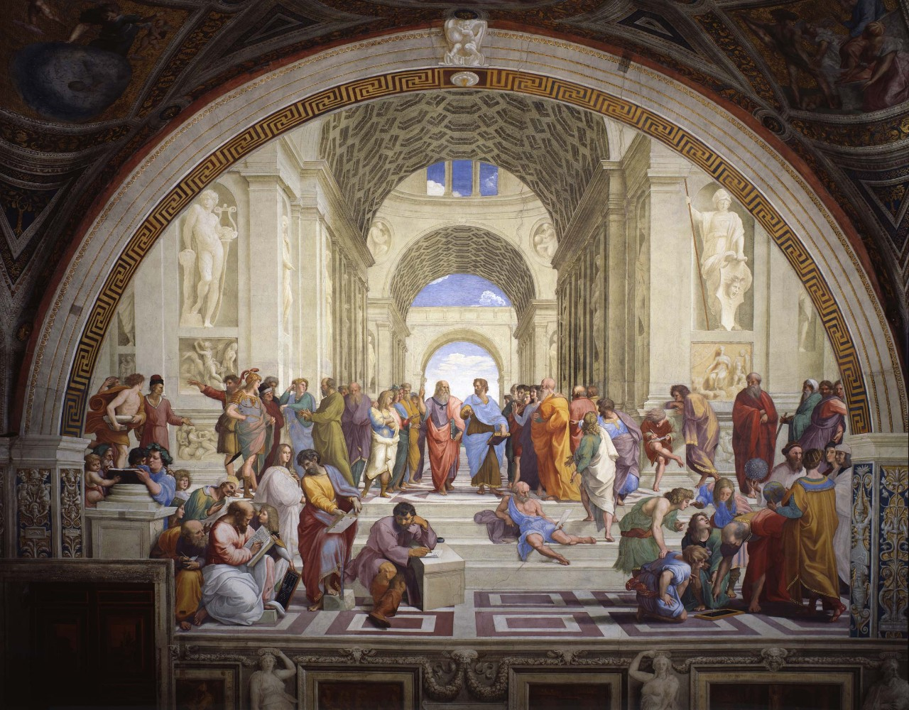
30 most Famous works of art Everyone should know
SELF TEST

Slide 2
Test yourself!
For each slide, write down the following:
Artist:
Title of Artwork:
Genre:

Slide 12
Rembrandt documentary: HERE (Good)

Slide 19
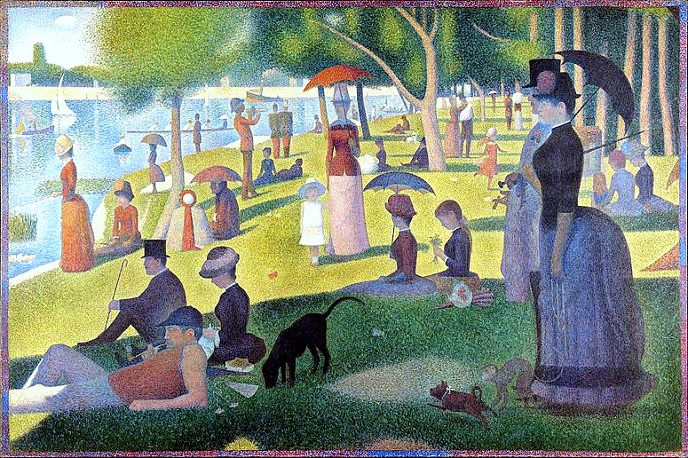

Slide 20
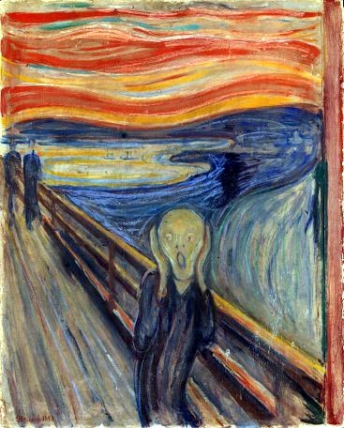

Slide 24
American Gothic is a 1930 painting by Grant Wood in the collection of the Art Institute of Chicago. Wood was inspired to paint what is now known as the American Gothic House in Eldon, Iowa, along with "the kind of people I fancied should live in that house". It depicts a farmer standing beside his daughter – often mistakenly assumed to be his wife

Slide 33
The EnD
How did you do?
Check your answers by using the other presentation, 30 Most Famous Works of Art.

